Slide 1
Adventurer’s Archive
A D&D 5e Companion App
Notes:
Introduce the app -- what it’s for, etc.

Slide 2
What is Adventurer’s Archive?
A companion app for keeping track of character information.
Designed with D&D 5th Edition in mind.
Keep track of your equipment and spells!
Roll skills during gameplay!
Share your character sheet with friends!

Slide 3
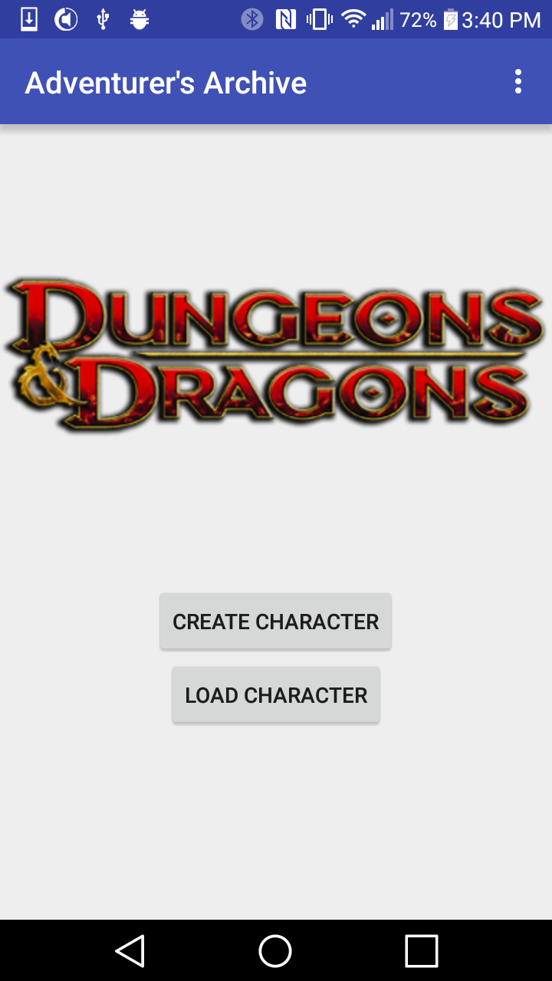
Main Activity
The first activity you’ll see.
From here you can create or load a character.

Slide 4
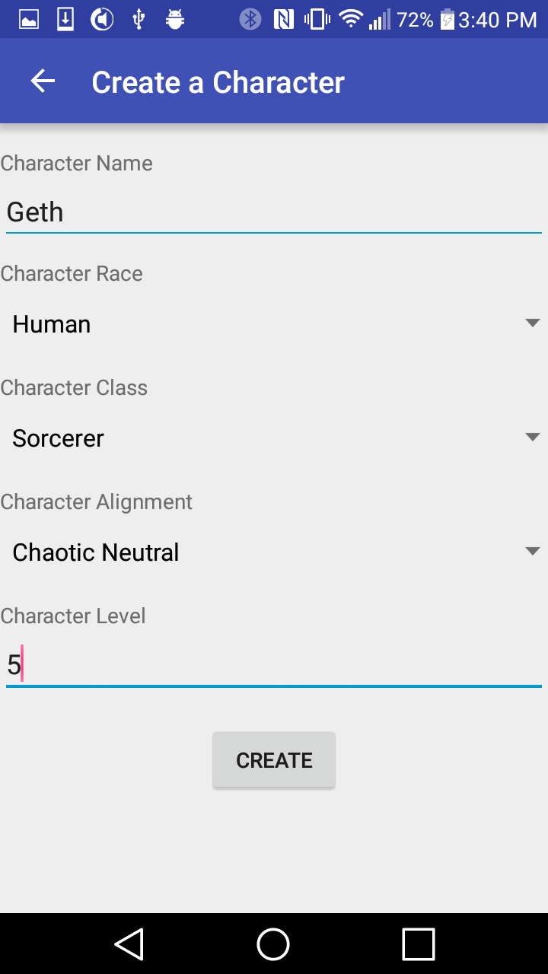
Create Character Activity
Enter basic character information.
Saves your character to a file.

Slide 5
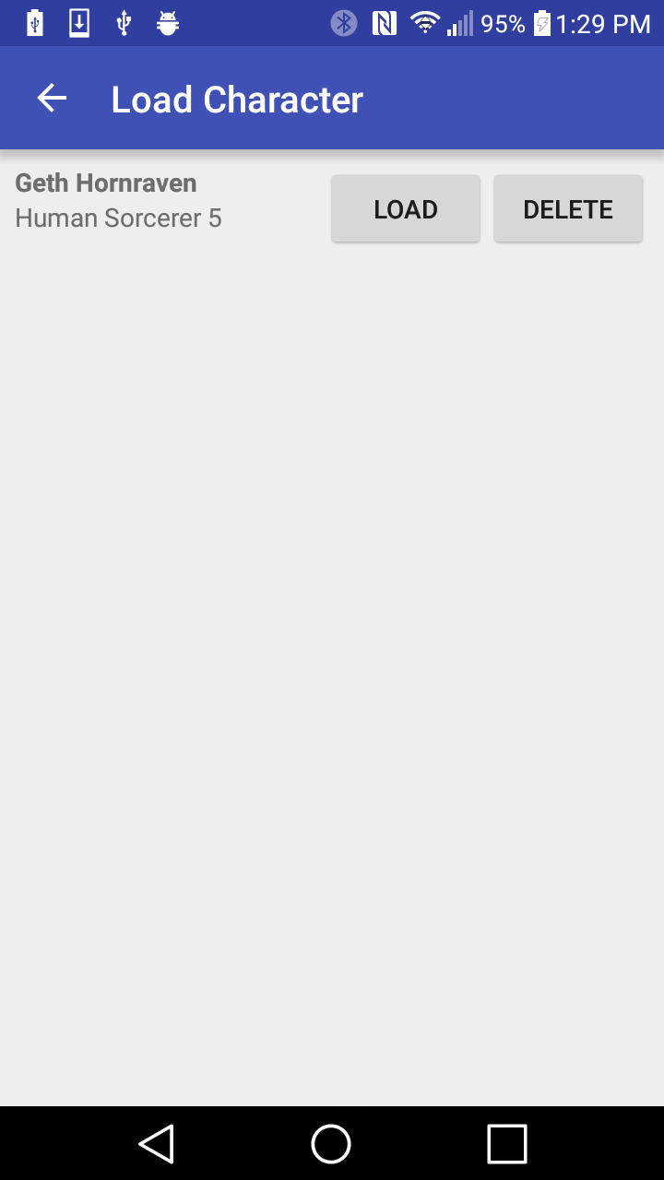
Load Character Activity
From here, load character information from files.
Or, delete your characters.
Saves all characters to “.aci” files.
Files are CharacterInfo objects serialized.

Slide 6
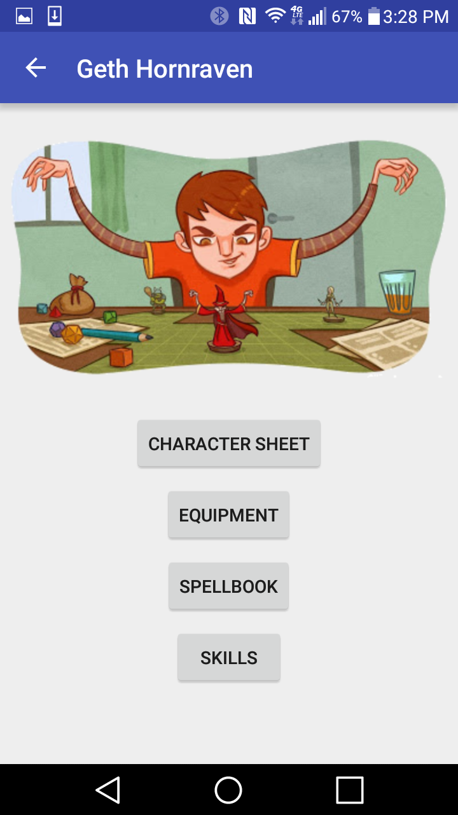
Character Main Activity
Takes you to all the character info activities.
Character Sheet has all important character info.
Equipment has details on equipment and wealth.
Spellbook keeps track of all your spells.
Skills lets you roll skill checks.

Slide 7
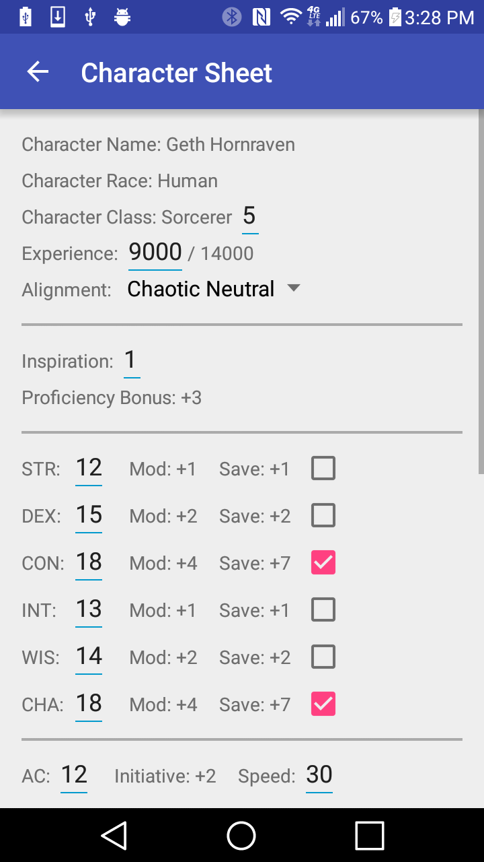
Character Sheet Activity
All important character information.
Basic character info
Ability scores and modifiers/saves
Vitals (HP, AC, etc)
Death saving throw successes/failures
Proficiencies, Languages, Features/Traits
Automatically updates immutable fields

Slide 8
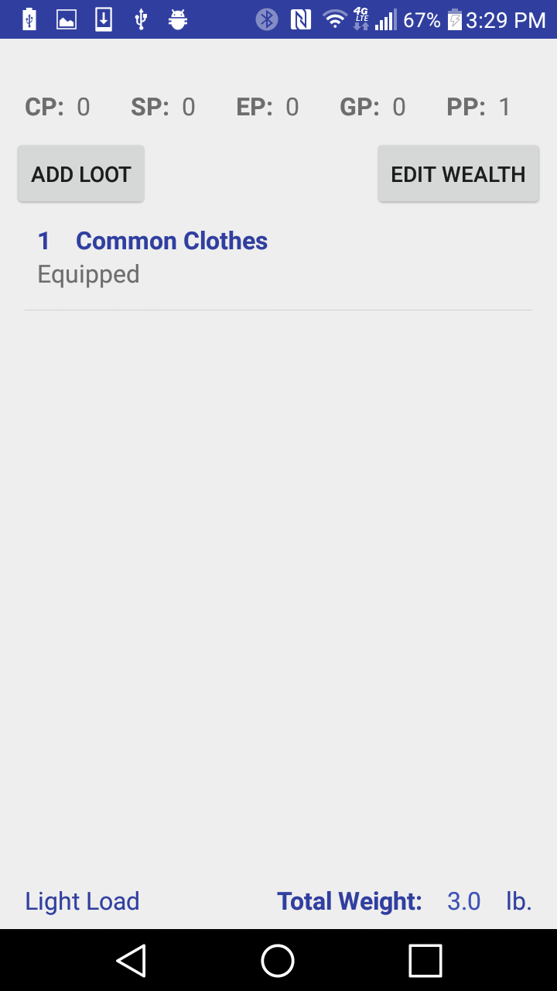
Character Equipment Activity
Displays character wealth and lets you edit it.
Displays equipment in character inventory.
Can add more equipment via “Add Loot”.
Shows equipment load and total weight.

Slide 9
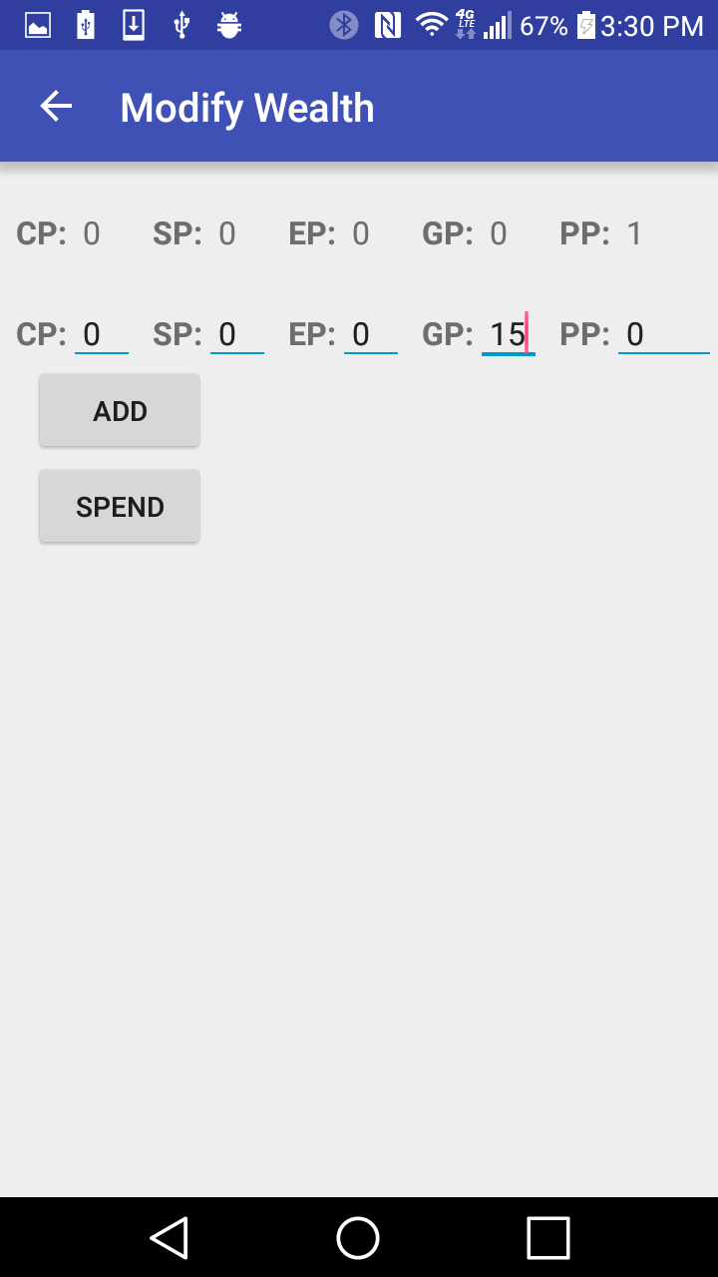
Edit Wealth Activity
Add/Subtract money from your current total.
Values are automatically converted.

Slide 10
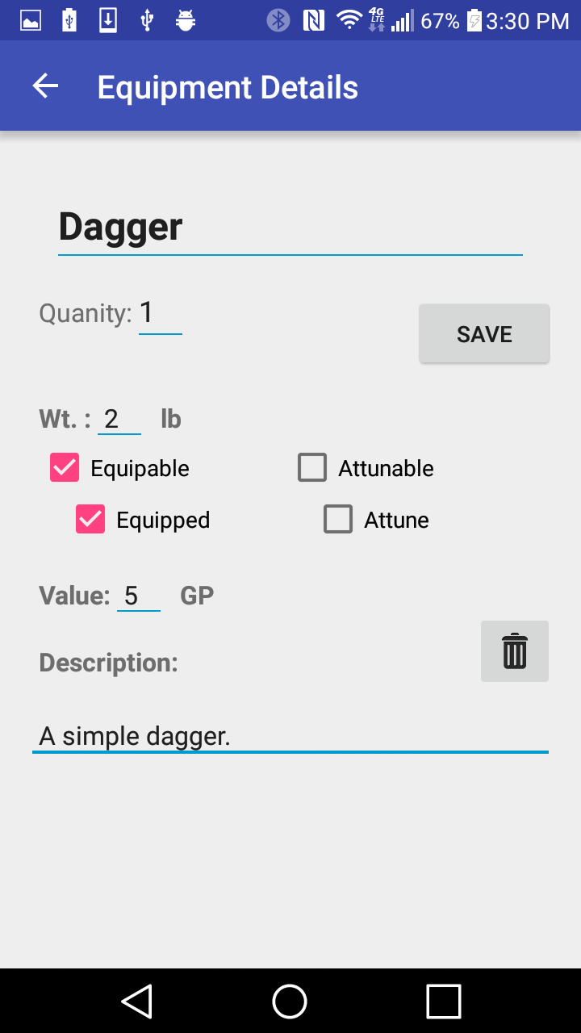
Add Equipment Activity
Requests basic information about equipment.
Can also delete the equipment via trash button.

Slide 11
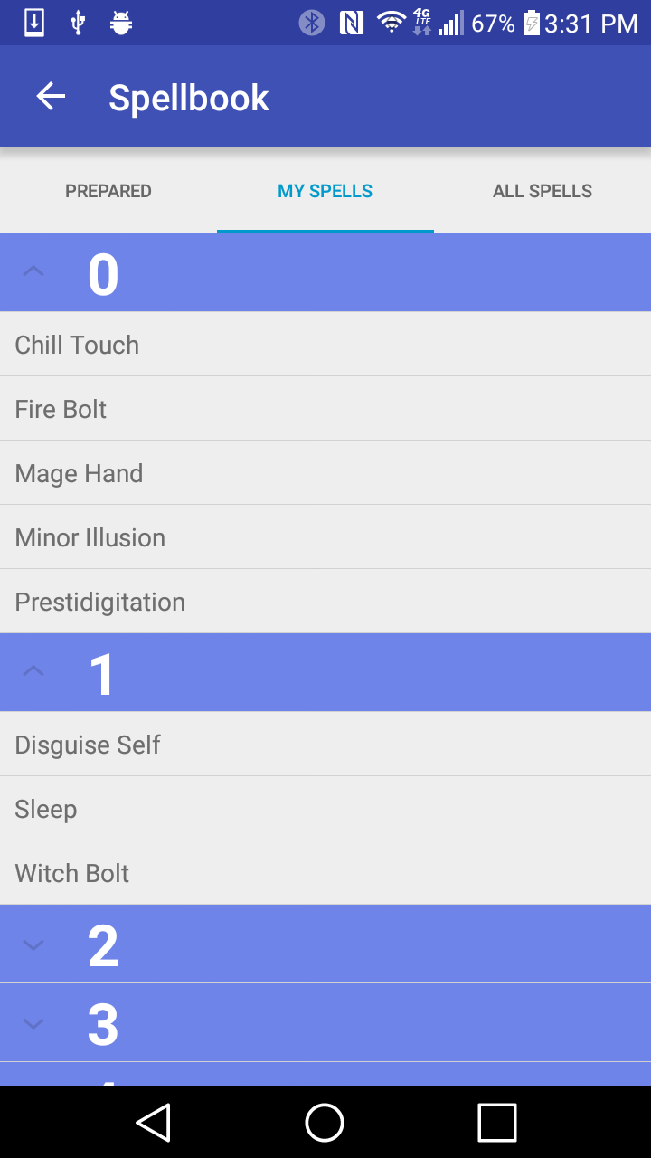
Character Spellbook Activity
Keep track of known spells and prepared spells.
See all spells available to your class.
Add spells to your spellbook.
Add known spells to your prepared spells list.
Tap spell name to see spell details.

Slide 12
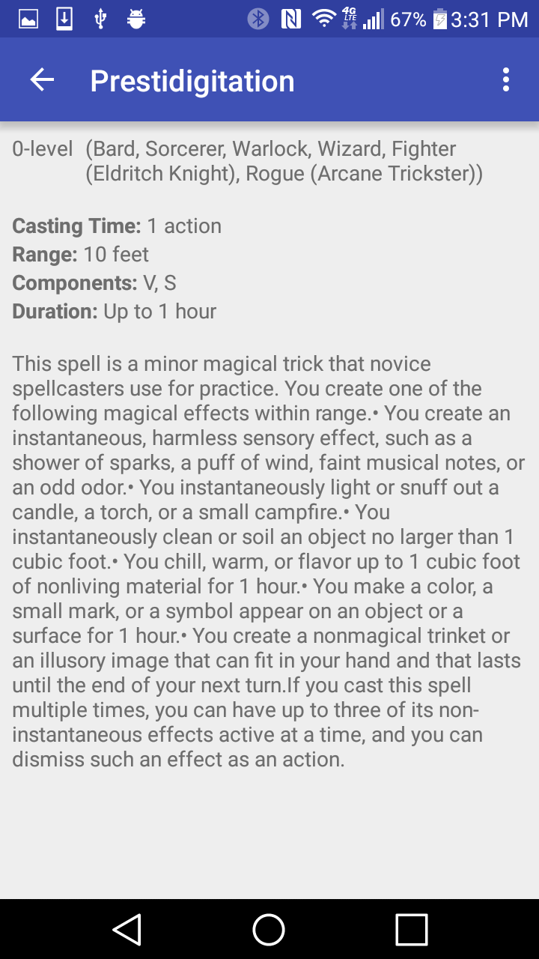
Display Spell Activity
Shows all relevant spell information.
Action overflow lets you to learn/prepare spell.

Slide 13
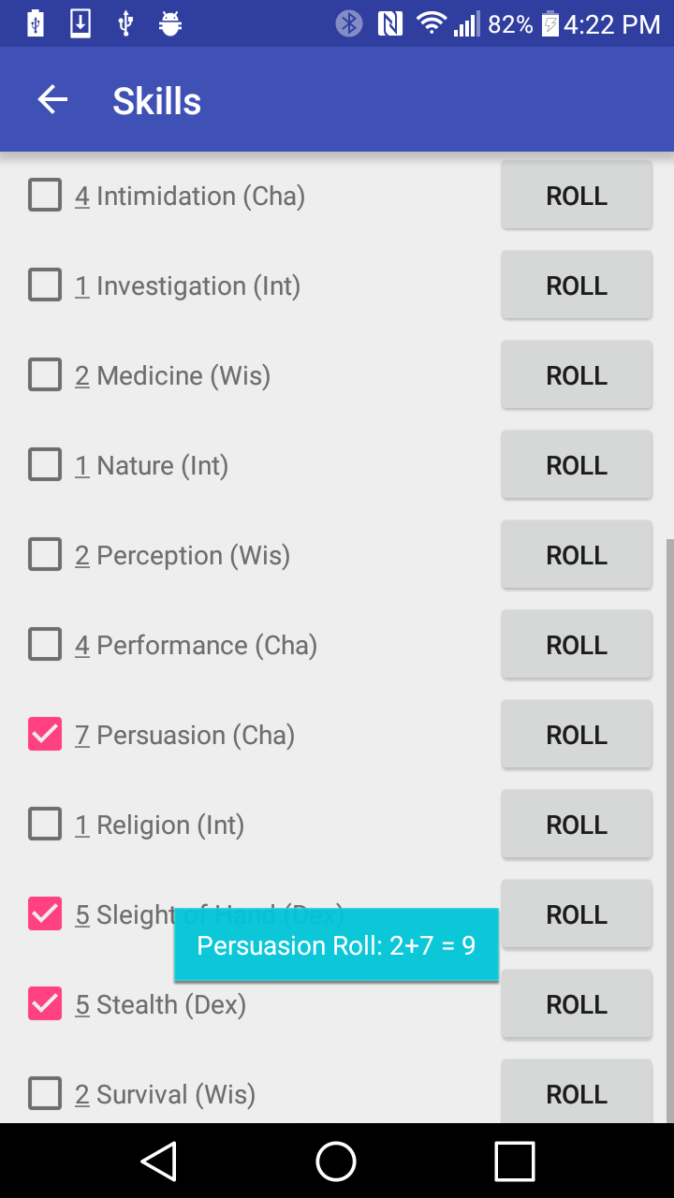
Character Skills Activity
Displays all character skills and skill bonuses.
Allows you to make skill checks.
Skill checks displayed in a toast.
Shows roll and bonus, then total.

Slide 14
Credits
Darin Beaudreau (Project Leader)
Ethan Goldman (Project Idea, Programming)
Anthony Rinaldi (Programming, Team Report)

Slide 15
FIN

